Slide 1
Turn on Touch ID for the lock screen
If you have been using a 4 digit passcode or a safer, longer alphanumeric code and it seems tiresome, there is now a way to keep your phone safe while avoiding the hassle of entering in a code every time. The iPhone 5s or late now allows you to use your fingerprint to access your phone. Follow these steps to learn how to turn on Touch ID easily and quickly.

Slide 2
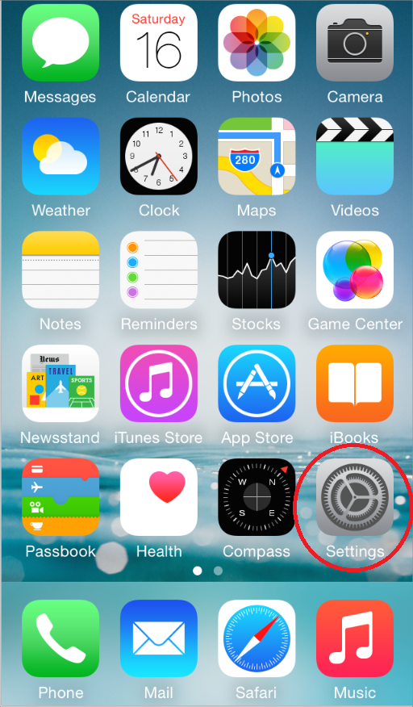
Step 1
First click on the Settings app on your homescreen.
Image courtesy of: iOS Developer Library

Slide 3
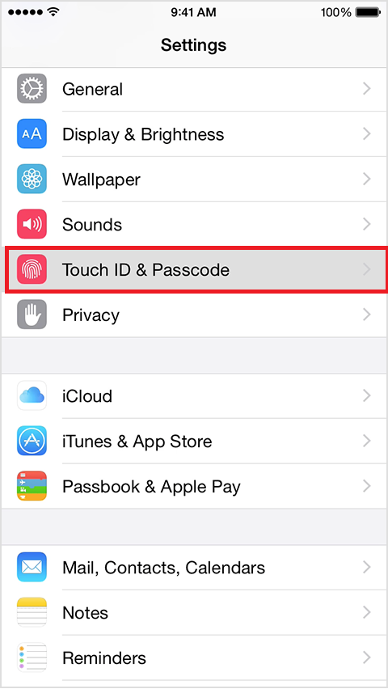
Step 2
Now scroll down and tap on the Touch ID & Passcode option in the Settings menu.
Image courtesy of: Apple Support

Slide 4
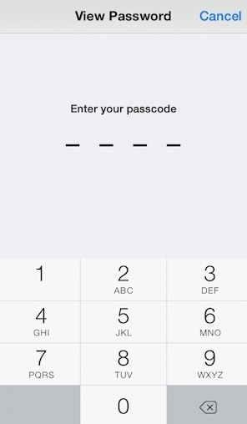
Step 3
Now if you are prompted you will need to enter your passcode on this next screen.
Image courtesy of: Jaysukh Patel

Slide 5
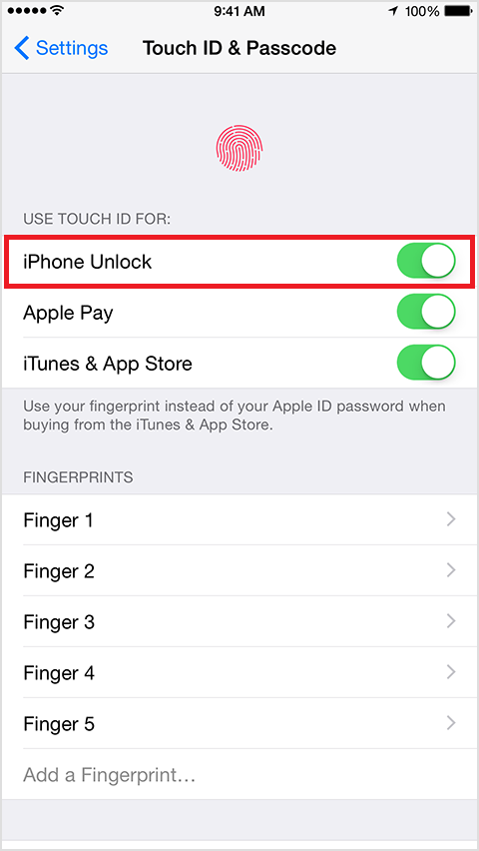
Step 4
Finally under the Use Touch ID For section slide the toggle to ON for the iPhone Unlock option.
Image courtesy of: Apple Support

Slide 6
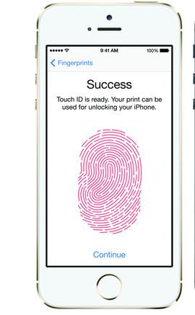
Step 5
At this point if you have set up a fingerprint already it will enable the previous setup, if you have not it will take you through the fingerprint setup process.
Image courtesy of: Madeline Bennett

Slide 7
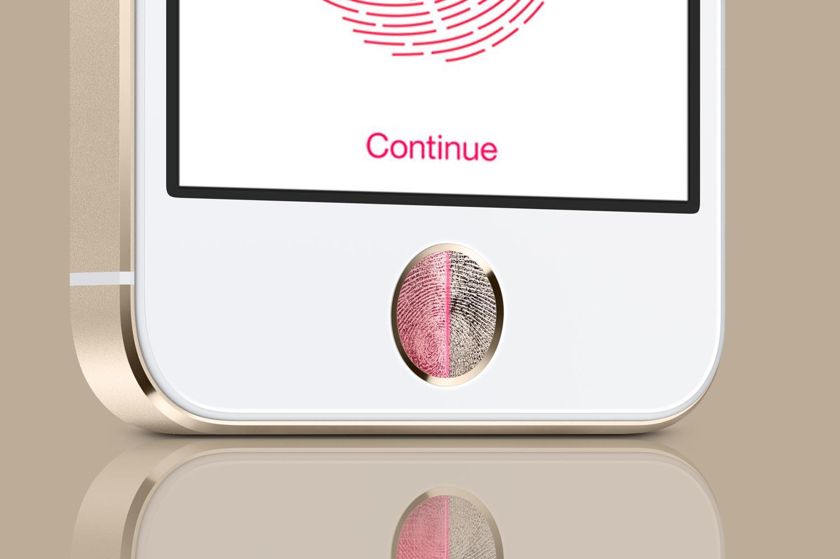
Step 6
That easy, you are all done! In the future when you want to unlock your iPhone you will have one simple step. Now you can know your phone is protected without the need to remember a long passcode.
Image courtesy of: Andrew Cout

Slide 8
Additional Resources
For more information click the links below:
https://www.apple.com/iphone-6/touch-id/
http://www.imore.com/touch-id
https://www.youtube.com/watch?v=TJkmc8-eyvE

Slide 9
References
http://www.imore.com/how-to-secure-iphone-ipad-touch-id
https://developer.apple.com/library/ios/documentation/UserExperience/Conceptual/MobileHIG/AppIcons.html
http://support.apple.com/en-bn/HT204060
http://www.howtoisolve.com/how-to-disable-notification-and-siri-icon-on-lock-screen-in-ios-8/
http://support.apple.com/en-bn/HT5883
http://www.theinquirer.net/inquirer/review/2303558/iphone-5s-vs-iphone-5-head-to-head-review/page/2
http://www.digitaltrends.com/mobile/can-apple-hand-over-your-fingerprint-to-the-nsa/

